Slide 1
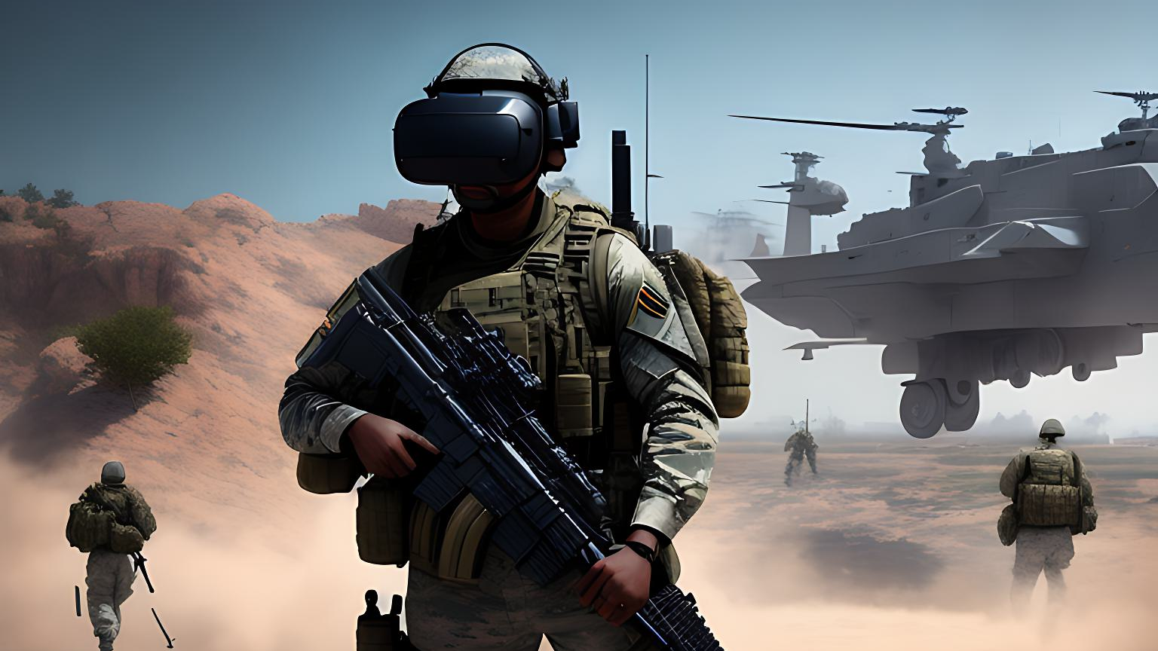
VISIONARY VANTAGE
THE FUTURE OF MILITARY TRAINING : INTEGRATING VR AND IRIS SCANNING

Slide 2
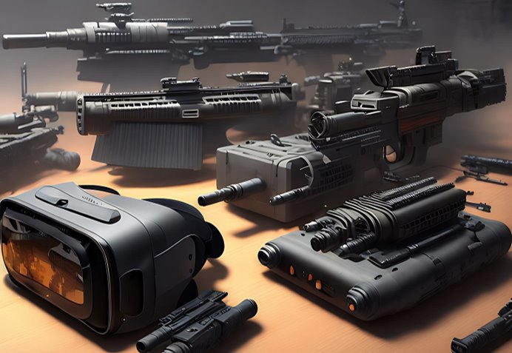
objective
Realistic and immersive training
Experiencing unreal situations
Improve the skills, readiness
Reduce the risk of injuries and death

Slide 3
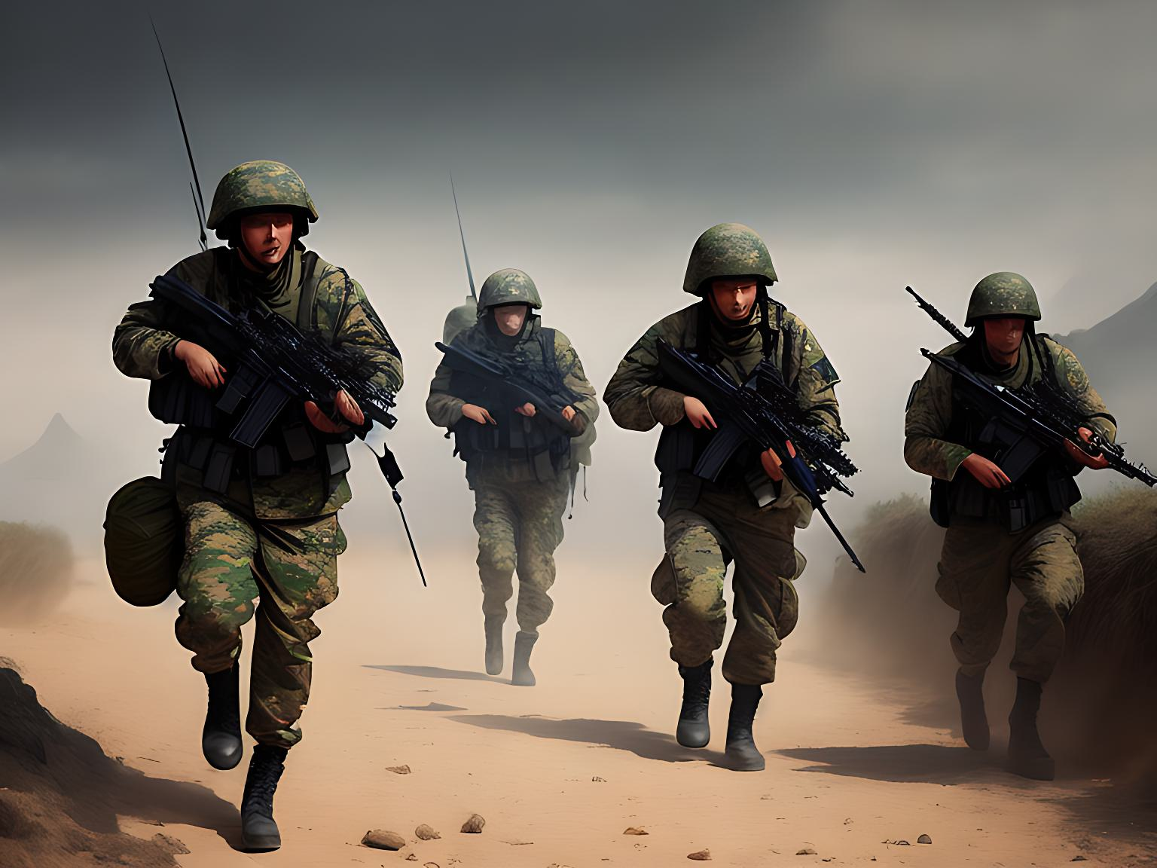
PROBLEM DEFINITION
High costs associated with training exercises
Risk of injuries and fatalities
Limited access to certain training environments
Difficulty in replicating certain scenarios
Limited feedback and evaluation options.

Slide 4
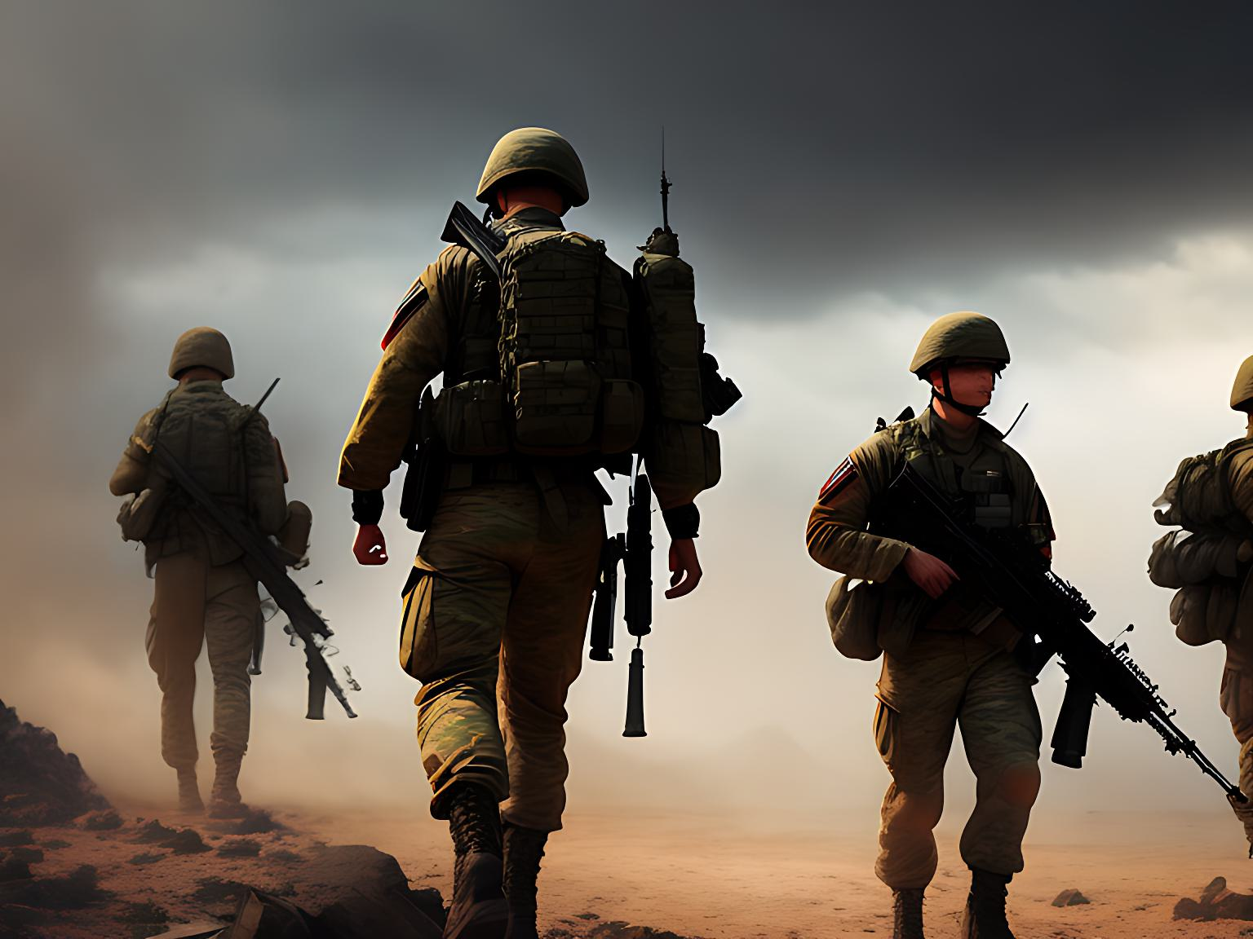
EXISTING TECHNOLOGY
Limited security in VR training.
Difficulty in analyzing performance.
Uniformity in training levels.
Inability to customize environments.
Limited player identification.

Slide 5
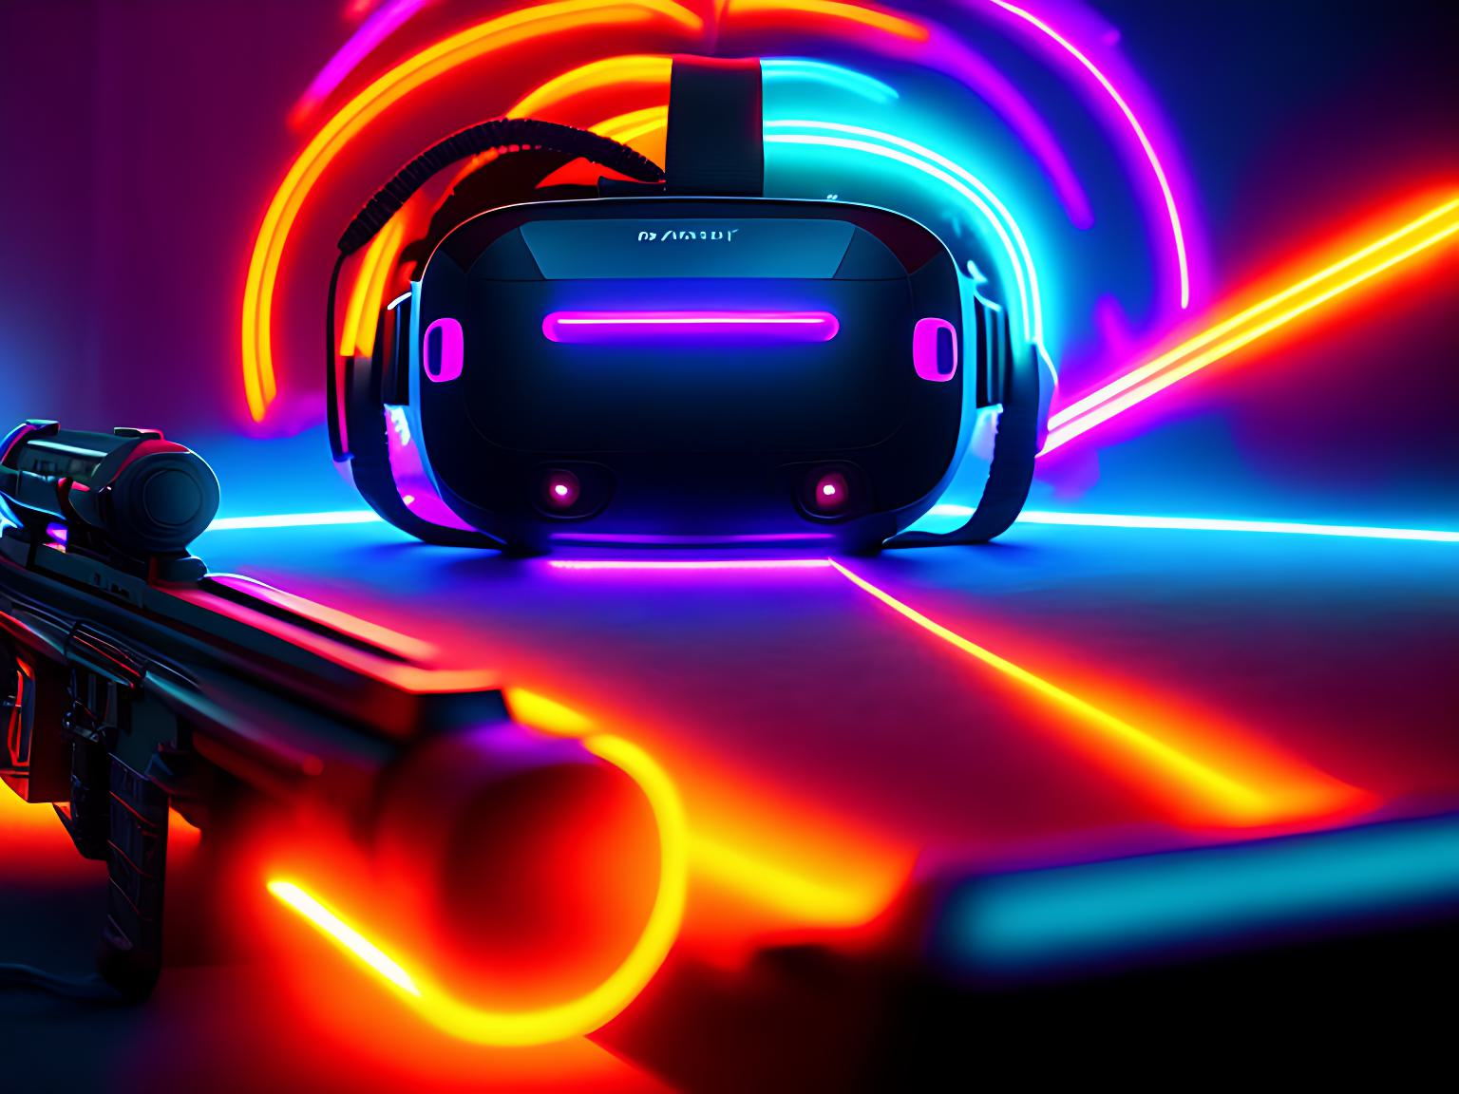
PROPOSED SYSTEM
Adding iris recognition technology
Provides secure identification
Tracks progress and performance
Enables level-based play
Analyzes individual player performance.

Slide 6
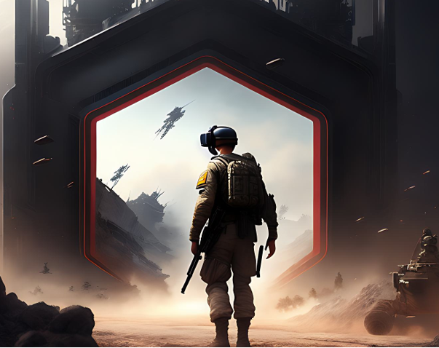
abstract
The Indian army is a symbol of dedication and sacrifice ,it's crucial to provide personalized training to each soldier. VR technology can help address the shortcomings of traditional military training and iris scan will determine each soldier's training level, and individual performance evaluation. Blockchain technology enhances secured training Our goal is to provide top-notch training by ensuring that they are always ready to defend the nation.

Slide 7
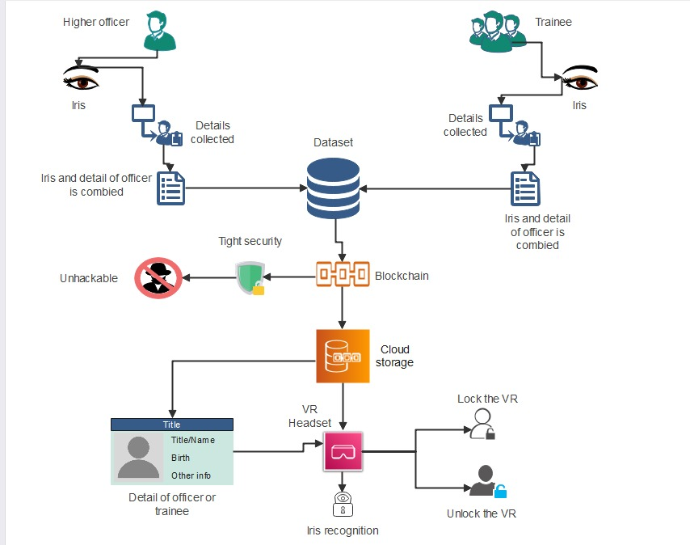
PROPOSED SYSTEM ARCHITECTURE

Slide 8
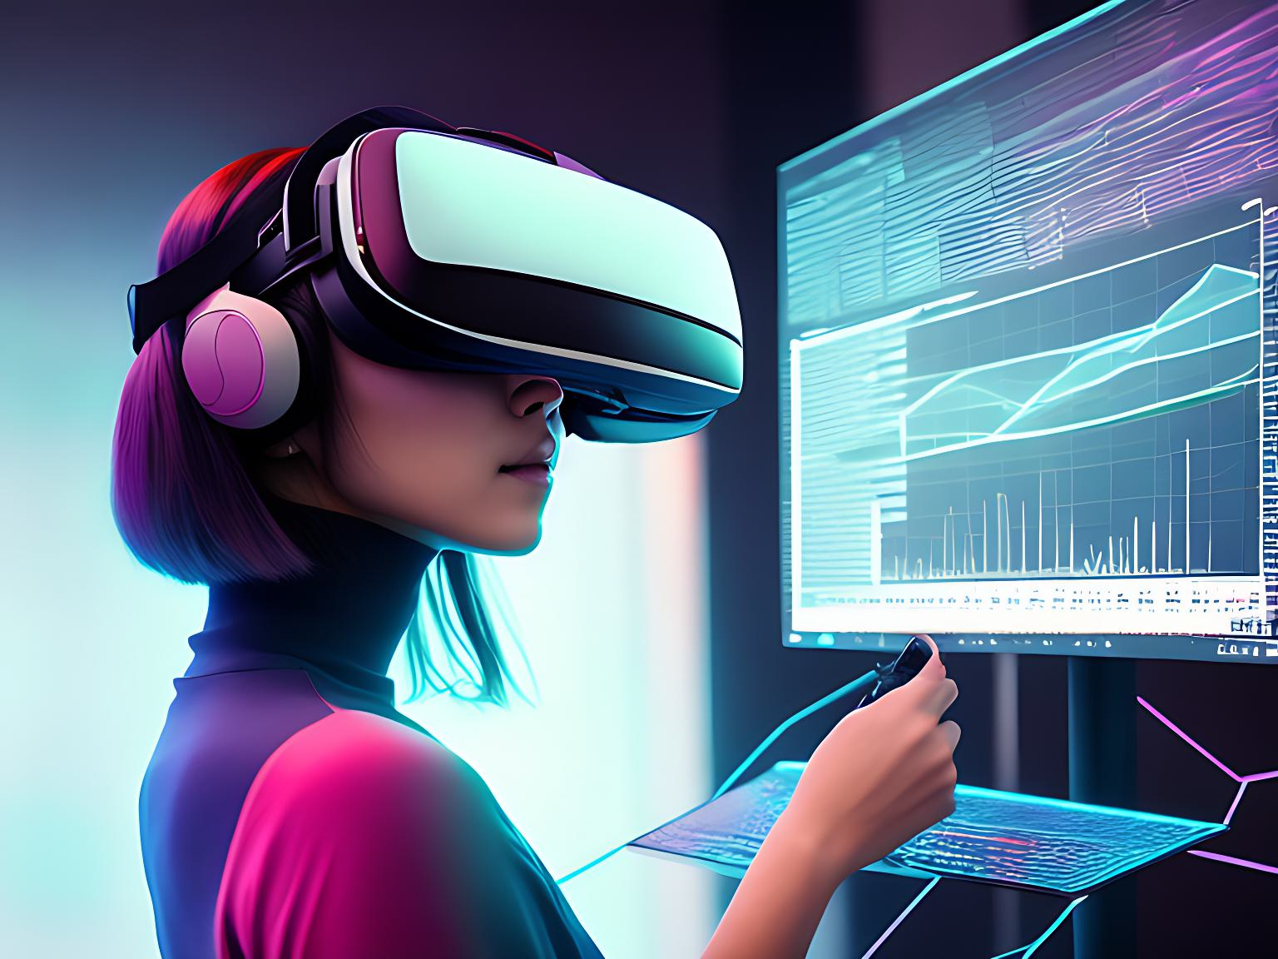
Work flow
Initialization: User provides personal and biometric data
Database creation: Securely store iris data and personal information
Identification: Capture and compare iris image for user's identity
Verification: Grant access if iris data matches, deny if not
Application usage: Training simulations, tactical planning, or live combat
Logging: Record user's activity for security

Slide 9

TECHNOLOGY USED
Image Processing
Blockchain Technology
Virtual reality
HARDWARE REQUIREMENTS
VR Headset
Hand Controllers
Iris ID iCAM7000 Series Camera
Powerful computer with high-end graphics.
SOFTWARE REQUIREMENTS
Unity
VeriEye
Blockchain technology
Machine learning algorithms
Cloud-based infrastructure

Slide 10
How this technology works?
VR device
Block chain
Iris recognition
Connect VR device to computer.
Enable Wi-Fi or Ethernet.
Connect to secure network.
Enter login credentials.
Ensure network security protocols.
VR devices can connect to blockchain.
Blockchain is non-hackable.
Provides secure data storage.
Enhances application security.
Protects sensitive military data.
Iris recognition verifies identity
Unique patterns match for access
Secure and accurate technology
Enhances personalized instruction

Slide 11
IRIS RECOGNITION
BLOCKCHAIN TECHNOLOGY
Biometric identification using iris
Highly accurate and unique
Used in security systems
Access control and verification
Decentralized, distributed ledger.
Ensures secure, transparent transactions.
Uses cryptography for data integrity.
Challenging to breach

Slide 12

Iris recognition ALGORITHM
Algorithm Employed
DAGUMAN ALGORITHM
Insight
WORKING
EFFICIENCY
Identifies individuals based on iris pattern
Highly accurate
Used in security systems, access control.
Perform iris segmentation
Normalize iris image
Encode iris features
Save iris images and features
Load iris feature arrays
Match iris images
Enhanced training
Reduced risk
Increased accessibility
Realistic simulation
WHAT MAKES THE ALGORITHM SUPERIOR?
Effective segmentation
Accurate normalization, Hamming distance
High accuracy and reliability

Slide 13

BLOCKCHAIN ALGORITHM
Algorithm Employed
SHA-256 BLOCKCHAIN ALGORITHM
Insight
WORKING
EFFICIENCY
Creates unique hash value
Generates 256 bit fixed size hash value
Secured Blockchain data
Uses cryptographic hash function.
Generates unique block hashes.
Links blocks in a chain.
Prevents data tampering.
Fast computation time
Low collision probability
Implementation versatility
Standardization
WHAT MAKES THE ALGORITHM SUPERIOR?
High Security against attacks
Efficient computation
Widely adopted in system

Slide 14
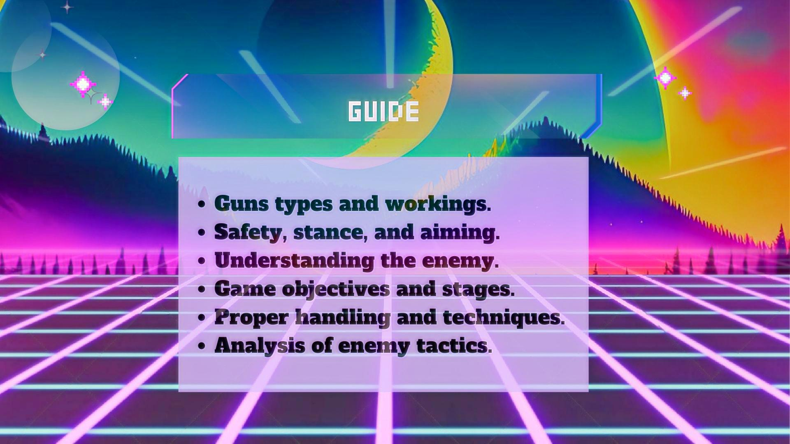

Slide 15
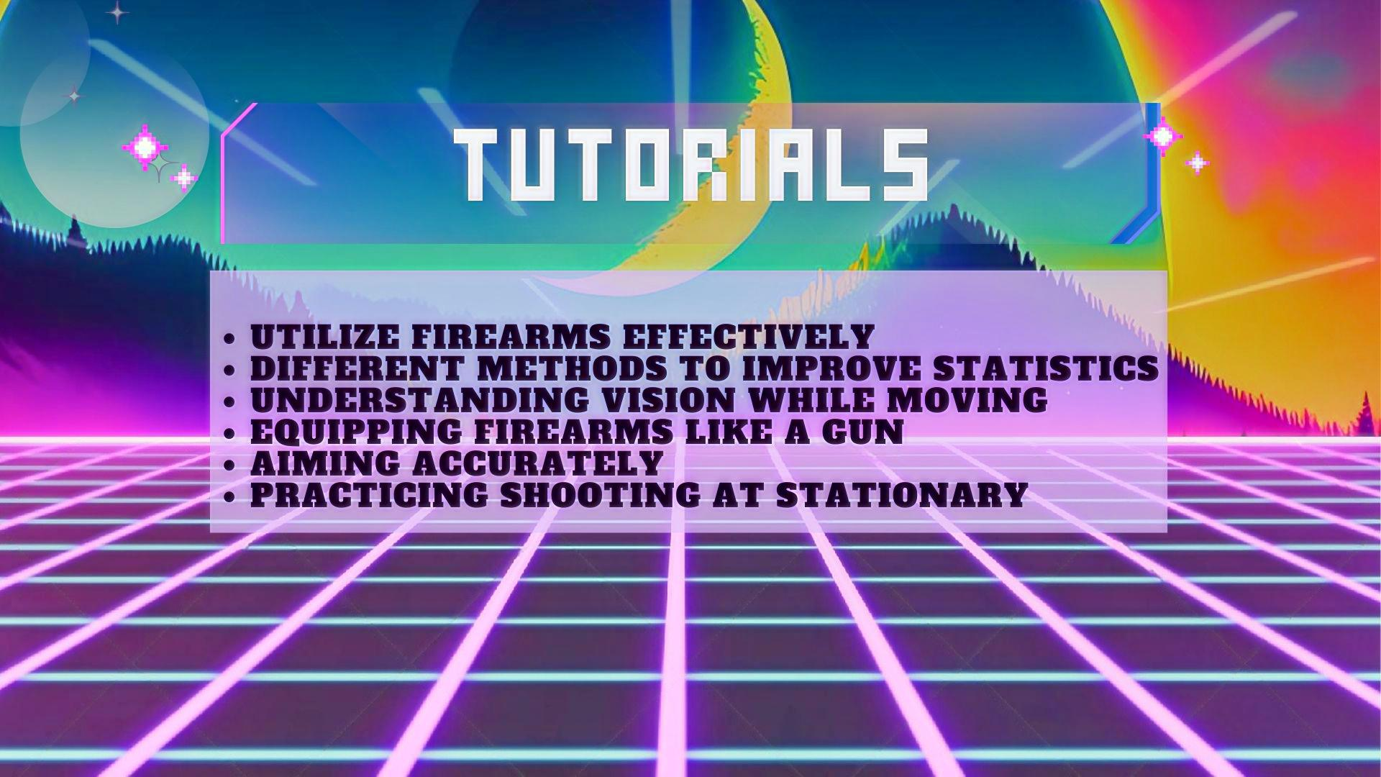

Slide 16
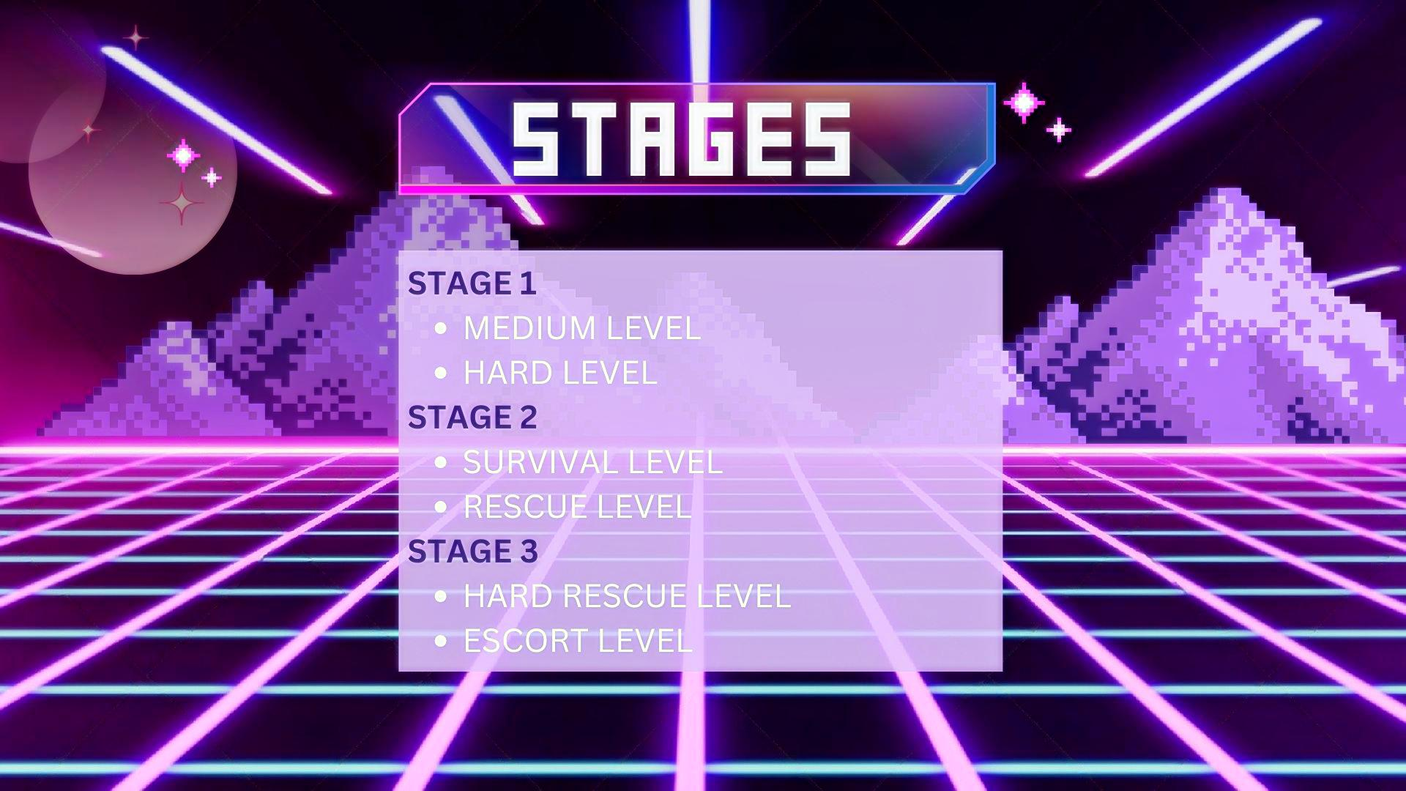

Slide 17
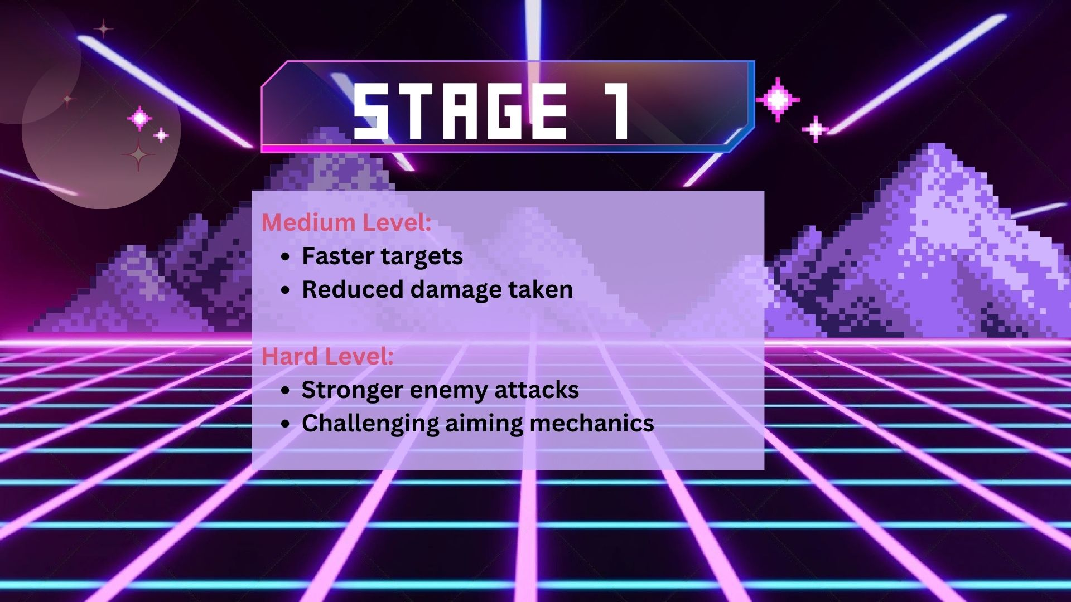

Slide 18
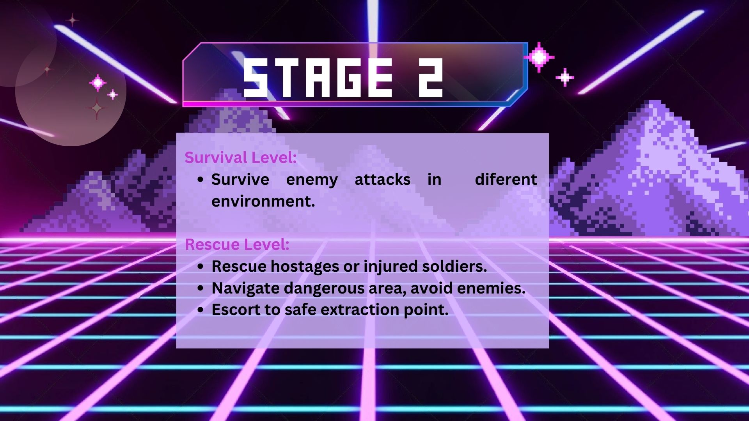

Slide 19
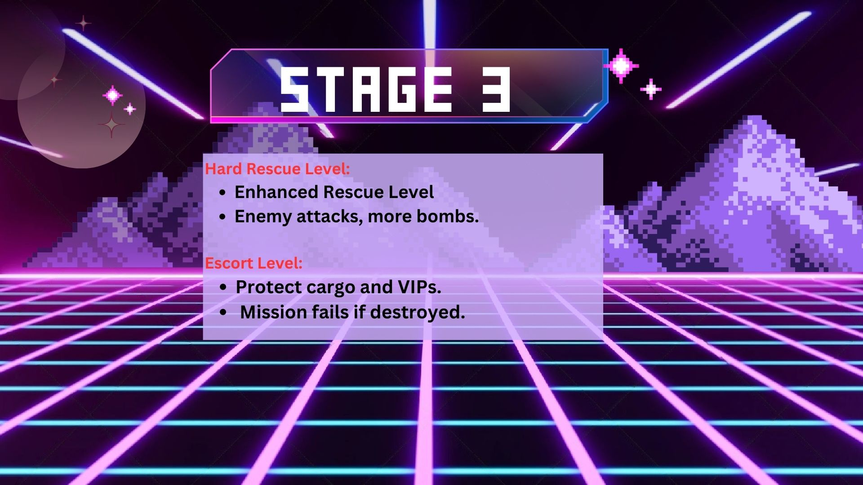

Slide 20
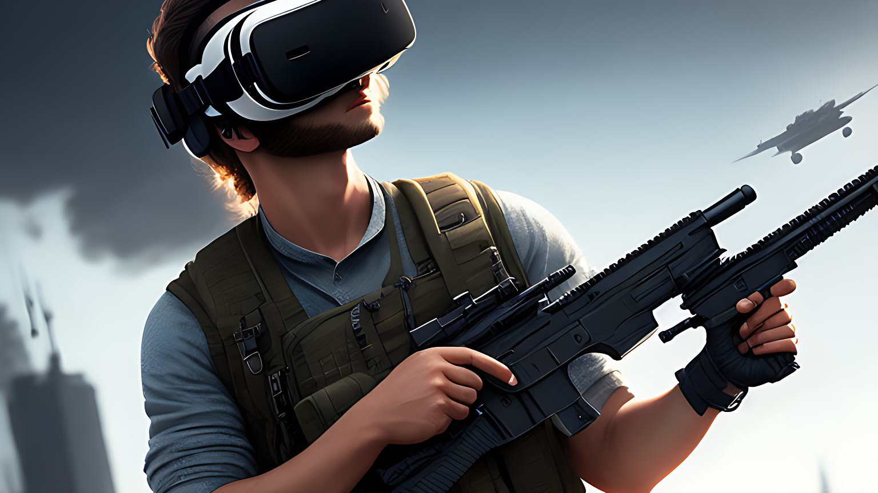
Product OVERVIEW
Efficient performance enhancement
Improved accuracy and performance
Secure training data
Tamper-proof data
Prevent data manipulation.

Slide 21
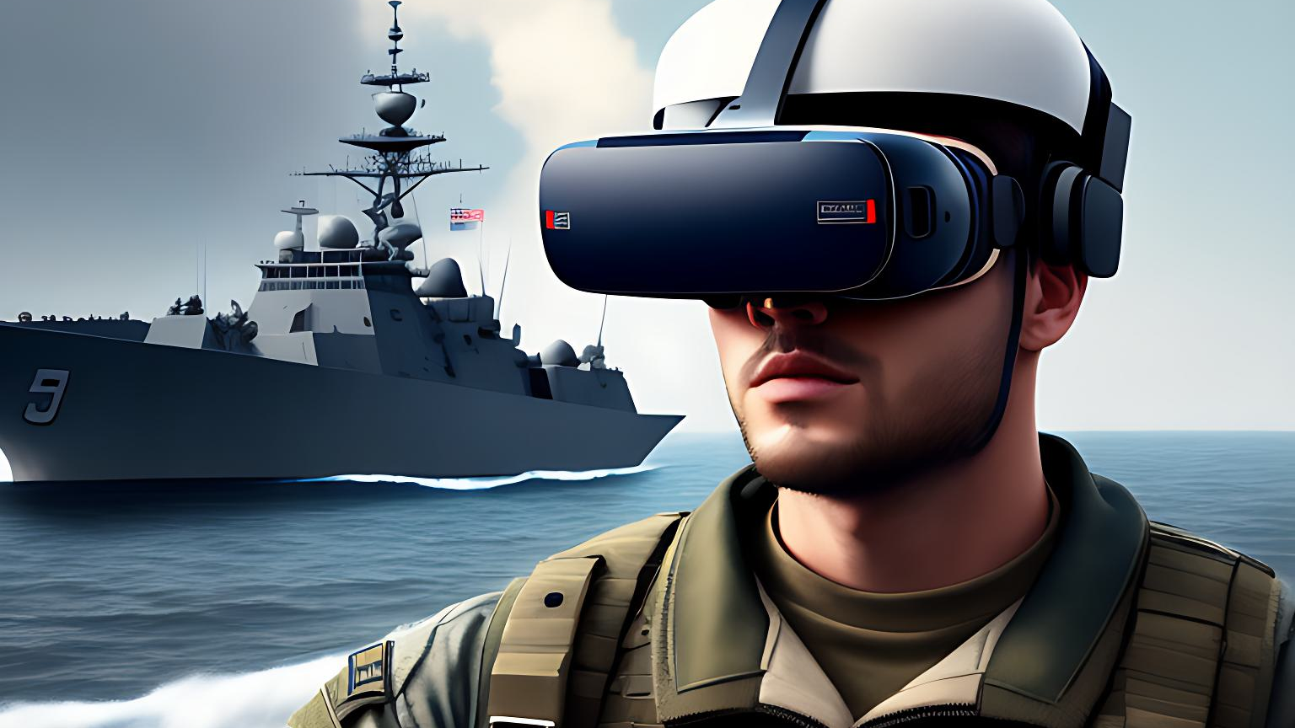
FUTURE ENHANCEMENT​
Tech integration for soldier training
Program expansion to other branches
Physiological monitoring and feedback
Collaboration with military experts
Advancement in training methodologies

Slide 22
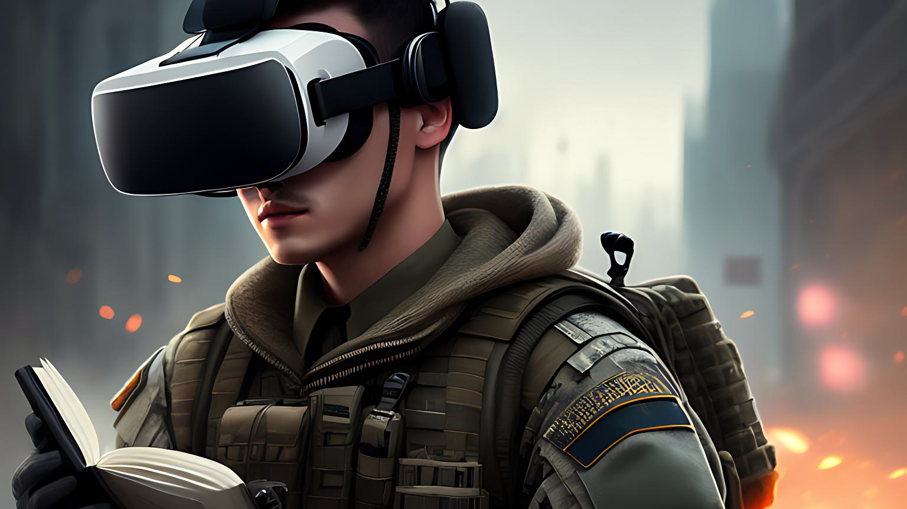
Reference
Jiang, F., Zhang, L., & Jiang, Y. (2022). An effective iris recognition system based on Daugman's algorithm and deep learning. Neural Computing and Applications, 34(6), 1931-1940.
Khan, M. A., & Khan, A. I. (2022). A systematic review of blockchain technology applications in healthcare: Current status, challenges, and future directions. Journal of Healthcare Engineering, 2022.
Xu, L., Wang, Q., & Pan, J. (2021). Research on Virtual Reality Training System for Ship Handling Based on Unity3D. Journal of Physics: Conference Series, 1913(1), 012054.
Yu, X., Wang, C., & Zou, Q. (2021). An Efficient Biometric Recognition System Based on Fusion of Iris and Fingerprint Features. Journal of Healthcare Engineering, 2021.
Wang, X., Sun, Y., & Zhang, Z. (2020). Research on Virtual Reality Technology in Military Training Simulation. In 2020 3rd International Conference on Computer Science and Application Engineering (CSAE) (pp. 476-480). IEEE.
Mokhtari, M., & Heidari, A. A. (2020). Combining iris and face recognition for multimodal biometric authentication in secure authentication environments. Computer Science and Information Systems, 17(1), 33-50.
Zhu, B., Zheng, Y., & Huang, G. (2019). A VR Training System for Aircraft Maintenance Based on Unity3D. In 2019 IEEE International Conference on Robotics and Biomimetics (ROBIO) (pp. 2544-2549). IEEE.
Li, X., & Cui, X. (2018). A virtual reality-based training system for crane operators. International Journal of Advanced Robotic Systems, 15(2), 1729881418760342.
Kouhizadeh, M., & Sarkis, J. (2018). Blockchain practices, potentials, and perspectives in green supply chain management. International Journal of Production Economics, 204, 383-398.
Ng, J. W., & Chan, S. C. (2018). Design and development of a low-cost virtual reality headset using open-source software and hardware. International Journal of Advanced Robotic Systems, 15(5).

